Slide 1
CS1010X Lecture 2:
Functional Abstraction,
Variable Scoping,
&
Picture Language
Notes:
Lecture 2a video

Slide 2
CS1010X Road Map
Memoization
Java Programming
ADVANCED
Searching & Sorting
Dynamic Programming
Object-Oriented Programming
INTERMEDIATE
Higher-Order Functions
List Processing
Multiple
Representations
BASIC
Functional Abstraction
Data Abstraction
Iteration
Mutation & State
Wishful Thinking
Recursion
Order of Growth
Fundamental concepts of computer programming

Slide 3
Functional Abstraction

Slide 4
How to square a number?
>>> 21 * 21
441

Slide 5
define
To square
something
>>> def square(x):
return x * x
return
something times
something

Slide 6
>>> square(21)
>>> square(2 + 5)
>>> square(square(3))
441
49
81

Slide 7
>>> def sum_of_squares(x, y):
return square(x) + square(y)
>>> sum_of_squares(3, 4)
25

Slide 8
>>> def hypotenuse(a, b):
return sqrt(sum_of_squares(a, b))
>>> hypotenuse(5, 12)
13

Slide 9
Function Definition
def <name>(<formal parameters>):
<body>
name
  The symbol to be associated with the function
formal parameters
  The names used in the body to refer to the actual arguments
body
  Contains expressions to be evaluated
  Has to be indented
  Can return value / function as output

Slide 10
Black Box
Function
Input
Parameters
Output
Just need to know what it does

Slide 11
Black Box
Function
Input
Parameters
Output
No need to know HOW it does the job! ☺

Slide 12
Return Type
Function
Input
Parameters
Output
Output is returned with return. Return type could be None.

Slide 13
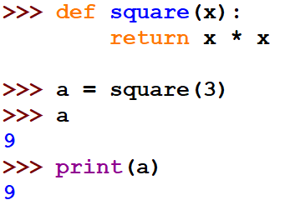

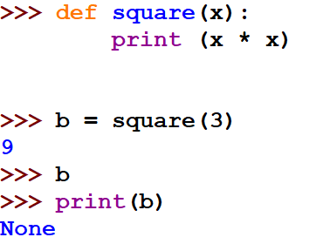

return vs print

Slide 14
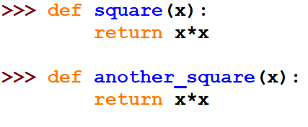



==
Notes:
This slide is not in the video

Slide 15
Variable Scoping
- understanding who you are talking about….
- It has to be the one closest to you

Slide 16
Variable Scoping
x = 10
def square(x):
return x * x
def double(x):
return x + x
def addx(y):
return y + x
x is bound
x is bound
y is bound,
x is free & refers to

Slide 17
Variable Scoping
body
formal parameter
def square(x): return x * x
A function definition binds its formal parameters
  i.e. formal parameters are visible only inside the definition (body), not outside

Slide 18
Variable Scoping
body
formal parameter
def square(x): return x * x
The formal parameters are bound variables
The region where a variable is visible is called the scope of the variable
  i.e. the scope of a formal parameter is the body of the function
Any variable that is not bound is free

Slide 19
Block structure
def hypotenuse(a,b):
def sum_of_squares():
return square(a) + square(b)
return math.sqrt(sum_of_squares())
Variables a and b in sum_of_squares refer to the formal parameters of hypotenuse
Hides irrelevant details (sum_of_squares) from the user of hypotenuse.
local function

Slide 20
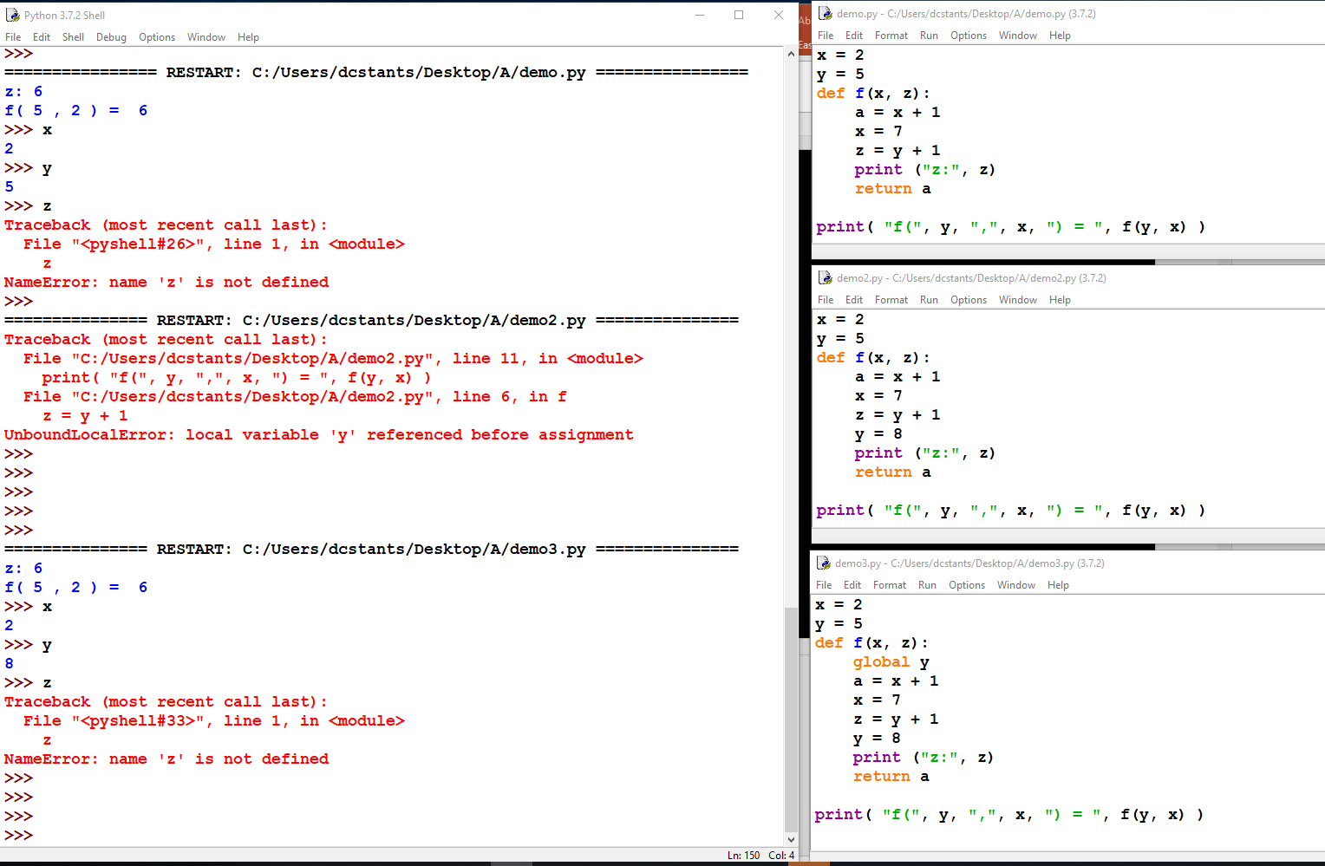

Slide 21
Variable Scoping
SUMMARY
Always use meaningful variable names
  Don’t save in your typing to forgo your understanding
Don’t overload the same variable names unnecessarily
For cryptic program, you can check out Python Tutor at:
http://www.pythontutor.com/
to trace your codes to find out

Slide 22
Abstract Environment:
Picture Language
(runes.py)
Need also graphics.py + image2gif.py
Notes:
Lecture 2b video

Slide 23
Importing Modules
>>> from runes import *
Insight: Often convenient to have code in different files for code reuse

Slide 24
Importing Modules
>>> import X # imports the module X
  # Can use X.name to refer to objects in X
>>> from X import *
# imports the module X, and creates references to
all public objects in X
  # Can use a plain name, i.e. something to refer to
  objects defined in module X. No need X.something
>>> from X import a, b, c
# imports the module X, and creates references to
the specified objects, in this case, a, b, and c.
  # Can now use a and b and c in your program.

Slide 25
Elements of Programming
Primitives
Means of Combination
Means of Abstraction

Slide 26
Elements of Programming
Primitives
Means of Combination
Means of Abstraction

Slide 27
1. Primitives
Operations available:
>>> clear_all ( )
>>> show ( pic )
>>> quarter_turn_right( pic )
>>> stack ( pic1, pic2 )
Working on pictures/data….
rcross_bb, nova_bb, sail_bb,
corner_bb, heart_bb

Slide 28
Applying operations
op(picture)
Example:
show(heart_bb)

Slide 29
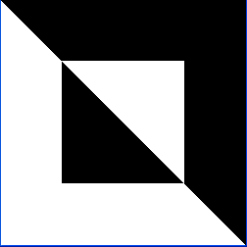




1. Primitives
>>> show (rcross_bb)
>>> show (nova_bb)
>>> show (sail_bb)
>>> show (corner_bb)
>>> show (heart_bb)

Slide 30
1. Primitives
>>> show (rcross_bb)
>>> show (nova_bb)
>>> show (sail_bb)
>>> show (quarter_turn_right(rcross_bb))

Slide 31
1. Primitives
>>> show (rcross_bb)
>>> show (nova_bb)
>>> show (sail_bb)
>>> show (quarter_turn_right(nova_bb))

Slide 32
1. Primitives
>>> show (rcross_bb)
>>> show (nova_bb)
>>> show (sail_bb)
>>> show (quarter_turn_right(sail_bb))

Slide 33
1. Primitives
>>> show (rcross_bb)
>>> show (nova_bb)
>>> show (sail_bb)
>>> show (stack(rcross_bb, nova_bb))
>>> show (stack(sail_bb, rcross_bb))

Slide 34
1. Primitives
>>> show (rcross_bb)
>>> show (nova_bb)
>>> show (sail_bb)
>>> show (stack(rcross_bb, nova_bb))
# multiple stacking
>>> show (
stack(sail_bb,
stack(rcross_bb, nova_bb) )

Slide 35
What can we do with just these?
Combination…

Slide 36
Elements of Programming
Primitives
Means of Combination
Means of Abstraction

Slide 37
2. Means of Combination
>>> show (rcross_bb)
>>> show (quarter_turn_right(rcross_bb))
>>> show (quarter_turn_right (quarter_turn_right(rcross_bb))

Slide 38
2. Means of Combination
>>> show (nova_bb)
>>> show (quarter_turn_right(nova_bb))
>>> show (quarter_turn_right (quarter_turn_right(nova_bb)))

Slide 39
2. Means of Combination
>>> show (sail_bb)
>>> show (quarter_turn_right(sail_bb))
>>> show (quarter_turn_right(quarter_turn_right(sail_bb)))
def turn_upside_down(pic):
return quarter_turn_right(
quarter_turn_right(pic))
result is a
picture
object!
return a picture object!

Slide 40
2. Means of Combination
>>> show (sail_bb)
>>> show (turn_upside_down (sail_bb))
>>> show (quarter_turn_right(turn_upside_down(sail_bb))))
def quarter_turn_left(pic):
return quarter_turn_right(
turn_upside_down(pic))
return a picture object!

Slide 41
2. Means of Combination
>>> show (sail_bb)
>>> show (turn_upside_down (sail_bb))
>>> show (quarter_turn_left(sail_bb))
>>> show (quarter_turn_right(
turn_upside_down(sail_bb)))

Slide 42
Elements of Programming
Primitives
Means of Combination
Means of Abstraction

Slide 43
3. Means of Abstraction
>>> show (sail_bb)
def turn_upside_down(pic):
return quarter_turn_right(
quarter_turn_right(pic))
>>> show (turn_upside_down (sail_bb))

Slide 44
3. Means of Abstraction
>>> show (sail_bb)
def quarter_turn_left(pic):
return quarter_turn_right(
turn_upside_down(pic))
>>> show (quarter_turn_left (sail_bb) )

Slide 45
3. Means of Abstraction
>>> show (stack(rcross_bb, nova_bb))
>>> show (stack(sail_bb, rcross_bb))
>>> show (beside (rcross_bb, nova_bb))
>>> show (beside (sail_bb, rcross_bb))

Slide 46
3. Means of Abstraction
def beside(pic1, pic2):
return quarter_turn_right(
stack(
quarter_turn_left( )
quarter_turn_left( )
)
)
pic2 ,
pic1
pic1 …left
pic2
>>> show (beside (sail_bb, rcross_bb))
turn
right

Slide 47

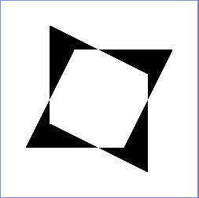

Nice…
>>> show (rcross_bb)
>>> show (nova_bb)
>>> show (sail_bb)
turn
right
turn
upside
down
SAME
SAME
original
turn
left

Slide 48
Making a cross…
>>> show (rcross_bb)
top half
upper right
stack(
beside(
quarter_turn_right(rcross_bb),
turn_upside_down(rcross_bb)
),
beside(
rcross_bb,
quarter_turn_left(rcross_bb)
)
)
upper left
bottom left
turn
right
turn
upside
down
bottom right
original
turn
left
bottom
half

Slide 49
Giving it a name…(abstraction)
>>> show (rcross_bb)
def make_cross(pic)
return
stack(
beside(
quarter_turn_right(pic),
turn_upside_down(pic)
),
beside(
pic,
quarter_turn_left(pic)
)
)
turn
right
turn
upside
down
>>> my_pic = make_cross(rcross_bb)
>>> show (my_pic)
original
turn
left

Slide 50
>>> show (rcross_bb)
>>> show (nova_bb)
>>> show (sail_bb)
>>> show (make_cross(rcross_bb))
>>> show (make_cross(nova_bb))
>>> show (make_cross(sail_bb))

Slide 51
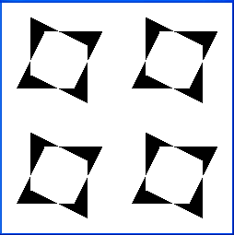
Okay…let’s get more
>>> show(nova_bb)
>>> show(make_cross(nova_bb))
>>> show(make_cross(make_cross(nova_bb))
>>> show(make_cross(make_cross(make_cross(nova_bb)))
>>> show(make_cross(make_cross(make_cross(make_cross(nova_bb))))

Slide 52
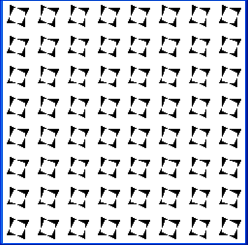
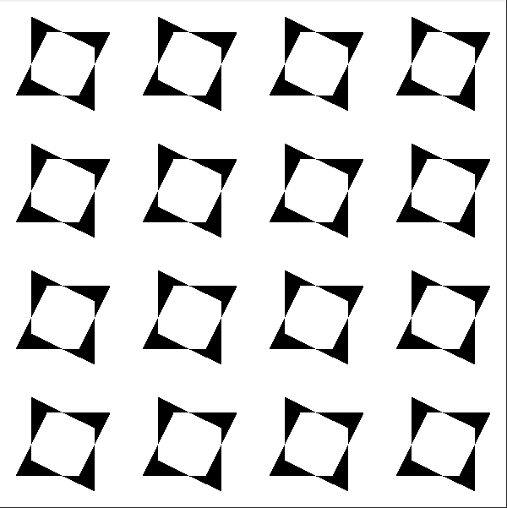
Repeating multiple times
make_cross
4 times
RECURSION
def repeat_pattern(n, pat, pic):
if n == 0:
return pic
else:
return pat(repeat_pattern(n-1, pat, pic))
>>> show(repeat_pattern(4, make_cross, nova_bb))
function

Slide 53
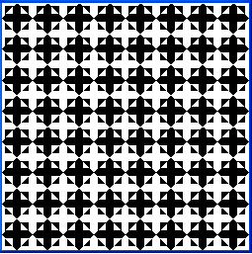
Okay…let’s get more
>>> show(repeat_pattern(4, make_cross, rcross_bb))
>>> show(repeat_pattern(4, make_cross, sail_bb))
???

Slide 54
Anonymous Functions (quick review)
def square(x):
return x * x
same as
square = lambda x: x * x
return w/o using the word return
input, can be more than one

Slide 55
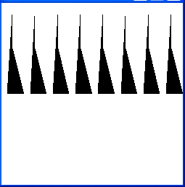
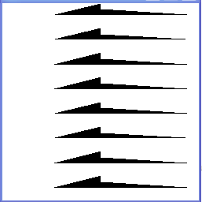
New Patterns
def repeat_pattern(n, pat, pic):
if n == 0:
return pic
else:
return pat(repeat_pattern(n-1, pat, pic))
>>> show(repeat_pattern(3,
lambda pic: beside(pic, pic),
nova_bb))
>>> show(repeat_pattern(3,
lambda pic: stack(pic, pic),
nova_bb))

Slide 56
What seems to be missing still?
Not so EVEN always,
but ODD and yet regular too…

Slide 57
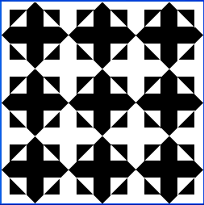
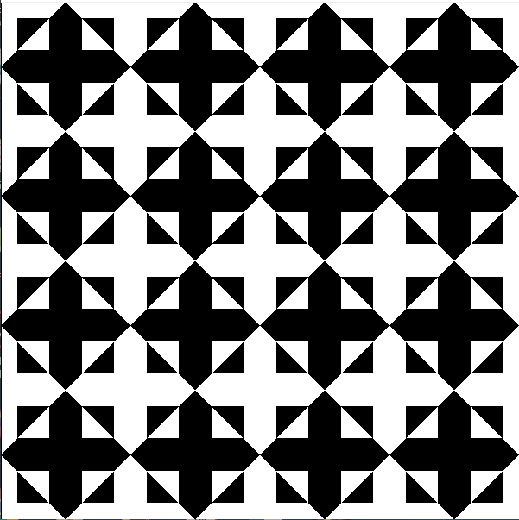
For example,
>>> show(repeat_pattern(4, make_cross, rcross_bb))
>>> show(repeat_pattern(3,
make_cross, rcross_bb))
Possible ?

Slide 58



For example,
>>> show(stack(rcross_bb, rcross_bb))
>>> show(stack( stack(rcross_bb,
rcross_bb),
rcross_bb))
Possible ?

Slide 59
Impossible !

Slide 60
1. Primitives (revised)
Operations available:
>>> clear_all ( )
>>> show ( pic )
>>> quarter_turn_right( pic )
>>> stack ( pic1, pic2 )
>>> stack_frac( frac, pic1, pic2 )
Working on pictures….
rcross_bb, nova_bb, sail_bb,
corner_bb, heart_bb

Slide 61
Now possible…
1/3 of the space
>>> show(stack_frac(1/3, rcross_bb,
stack(rcross_bb, rcross_bb)))
left with 2/3 of the space
Each of these takes 1/2 of the (2/3) space left, which is 1/3 of the whole space
1/3
2/3

Slide 62
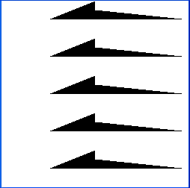
Extend stacking 3 to n…(abstraction)
def stackn(n,pic):
if n == 1:
return pic
else:
return stack_frac(1/n, pic, stackn(n-1, pic))
>>> show( stackn(5, nova_bb) )
1/5
4/5

Slide 63
What about…nxn (“wrong” version)
stack up
3 rows
def nxn(n, pic):
return stackn(n,
quarter_turn_right(
stackn(n, pic)))
show(nxn(3, make_cross(rcross_bb)))
result of
stack up then
turn right

Slide 64

What about…nxn (“wrong” version)
def nxn(n, pic):
return stackn(n, quarter_turn_right(
stackn(n, pic)))
show(nxn(3, nova_bb))

Slide 65
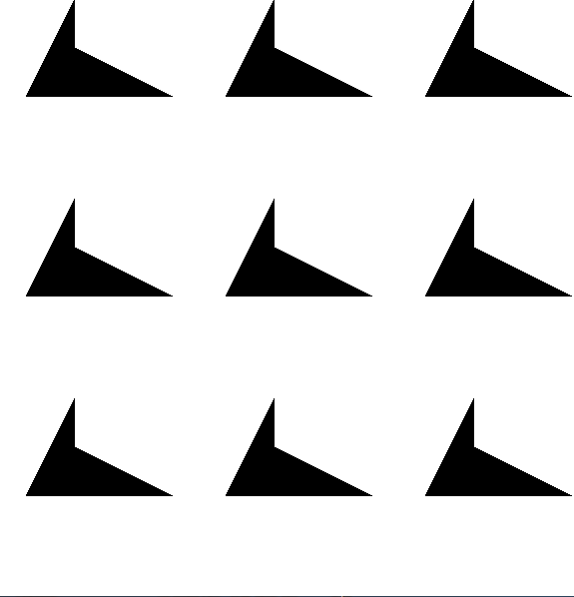
What about…nxn (correct verion)
def nxn(n, pic):
return stackn(n, quarter_turn_right(
stackn(n, quarter_turn_left (pic))))
show(nxn(3, nova_bb))

Slide 66
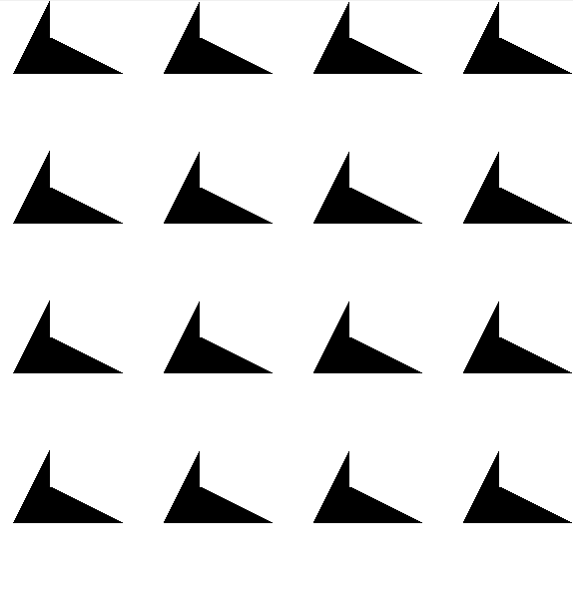
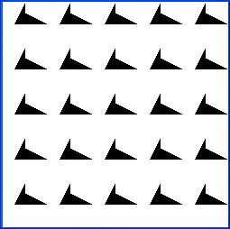

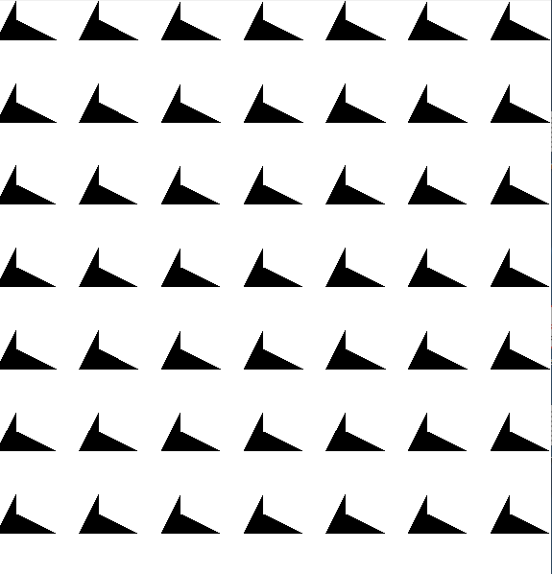
Quilting patterns
>>> show(nova_bb)
>>> show(nxn(3, nova_bb)
>>> show(nxn(4, nova_bb)
>>> show(nxn(5, nova_bb)
>>> show(nxn(6, nova_bb)
>>> show(nxn(7, nova_bb)

Slide 67
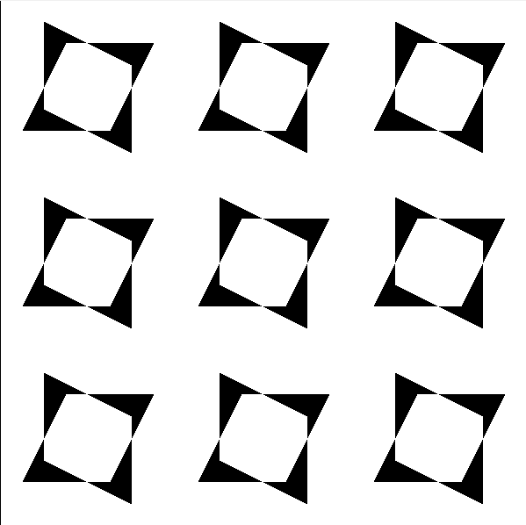
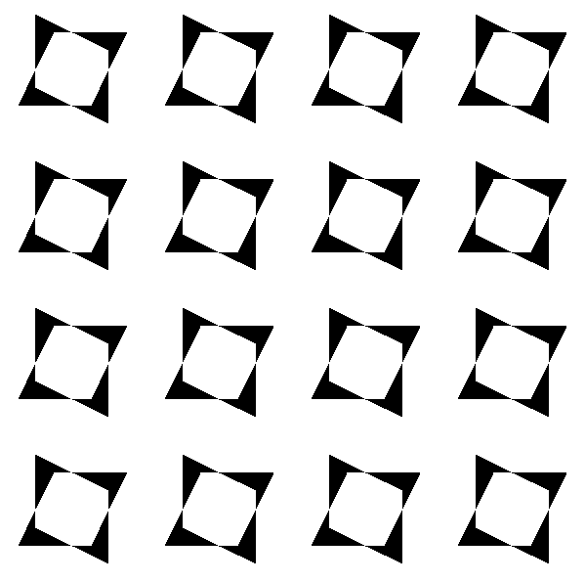
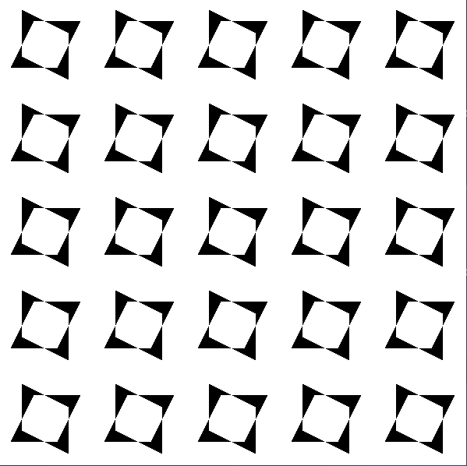
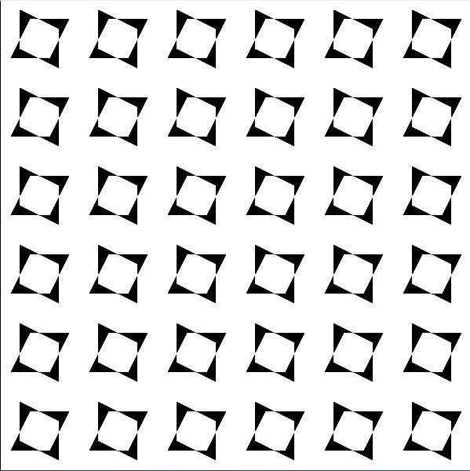
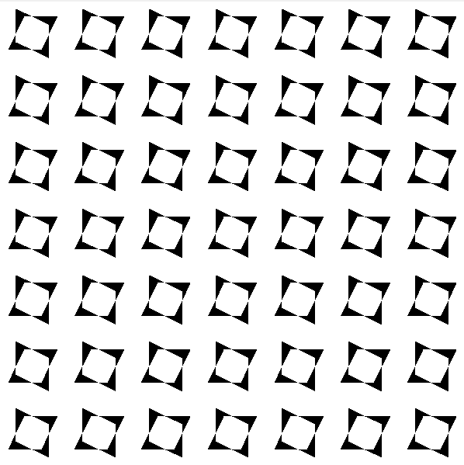
Quilting patterns
>>> a = make_cross(nova_bb)
>>> show(a)
>>> show(nxn(4, a)
>>> show(nxn(3, a)
>>> show(nxn(5, a)
>>> show(nxn(6, a)
>>> show(nxn(7, a)

Slide 68
Once we have an abstraction defined as function, we can use it as if it was a primitive
many of these are actually already defined in the runes.py
function nxn is not in runes.py

Slide 69
No idea how a picture is represented

Slide 70
No idea how the operations do their work

Slide 71
Yet, we can build complex pictures

Slide 72
Now it’s
Your turn to be creative!

Slide 73
Next video on Stereograms is courtesy of Ben Leong

Slide 74
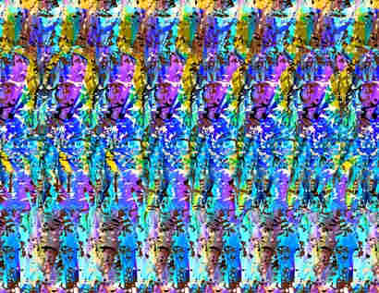
We can also make Stereograms!!
Notes:
Lecture 2c video

Slide 75
depth map
STEREOGRAM
GENERATOR
stereogram
function
Functional Abstraction

Slide 76


Slide 77
How do stereograms work?
Because there is a small separation between our eyes, they perceive slightly different images
These differences allow us to perceive depth.
Autostereograms work by repeating patterns in such a way as to give us an illusion of depth

Slide 78
How do stereograms work?
D
Image plane
C
A
B

Slide 79
Generation of stereograms
Key idea: compute the sets of points that are constrained to be of the same colour
Note that we can compute the required image one line at a time
How do we compute these sets?
Use simple geometry

Slide 80
Generation of stereograms
Create a 3-d model of the object
  Use a function f(x,y) to define the depth of an object
Decide on some parameters
  Distance between eyes and image
  Position of object relative to image plane
  Distance between the two eyes
Compute one line at a time

Slide 81
Generation of stereograms
Image plane

Slide 82
Generation of stereograms
Image plane

Slide 83
Generation of stereograms
Image plane
How far?

Slide 84
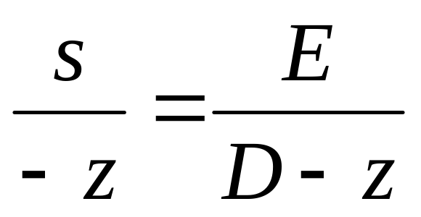
Generation of stereograms
-z
Image plane
A
s
D
E

Slide 85
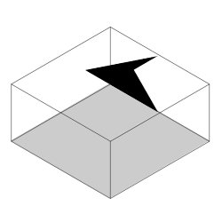
Creating 3D objects
We use greyscale to represent depth
  Black is nearest to you
  White is furthest away
means

Slide 86
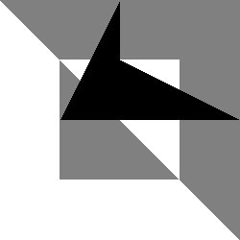
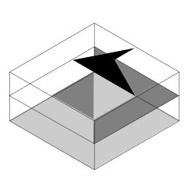
Creating 3D objects
means

Slide 87
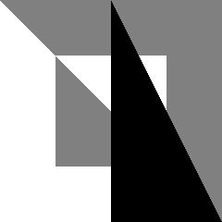
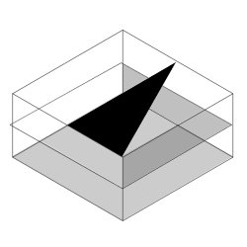
Overlay Operation
clear_all()
show(overlay(sail_bb, rcross_bb))

Slide 88

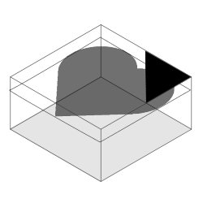
Advanced Overlay Operation
clear_all()
show(overlay_frac(1/4, corner_bb, heart_bb))

Slide 89

Scaling
clear_all()
show(scale(1/2, heart_bb))

Slide 90
depth map
Stereogram
generator
stereogram
stereogram(scale(1/2, heart_bb))
depth map

Slide 91
What if you cannot see stereograms?

Slide 92
Think Different
Image plane

Slide 93
Think Different
Image plane

Slide 94
Think Different
Image plane

Slide 95
3D Anaglyphs
Image plane
Use filters to show one image to each eye!

Slide 96
What else can we do to create an illusion of 3D?

Slide 97
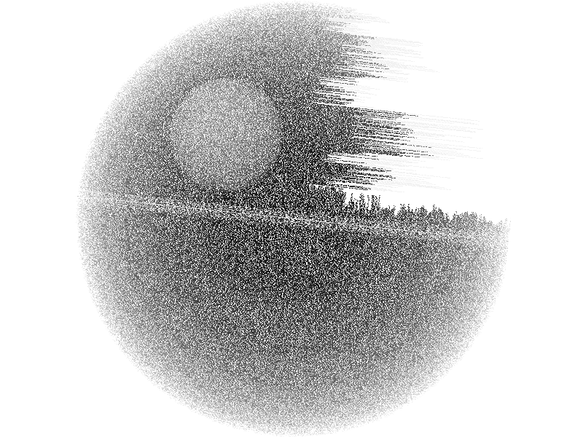

Slide 98
Simulating 3D Effect with Animation
Image plane

Slide 99
Simulating 3D Effect with Animation
Image plane

Slide 100
Simulating 3D Effect with Animation
Image plane

Slide 101
Simulating 3D Effect with Animation
Image plane

Slide 102
Simulating 3D Effect with Animation
Image plane

Slide 103
Simulating 3D Effect with Animation
Image plane

Slide 104
Simulating 3D Effect with Animation
Image plane

Slide 106
What have we learned?
Functional Abstraction
Assignment
Functions are objects
Anonymous Functions (lambda)
Recursion

Slide 107
Helps us manage complexity by focusing on high-level problem solving

